Slide 1
Beginner
Ad-Hoc, Greedy, Sorting, Searching
RakibJoy

Slide 2
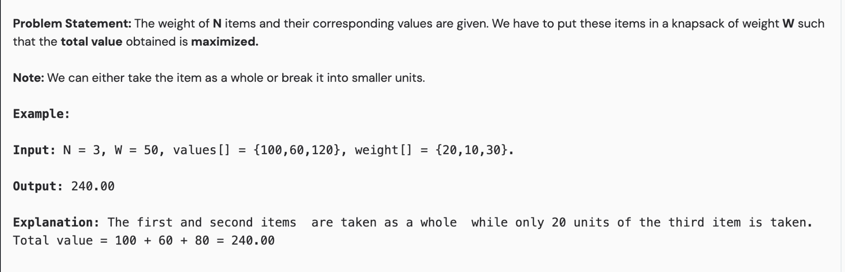
Think Like a Greedy Guy

Slide 3
What if we cannot break it into smaller elements!

Slide 4
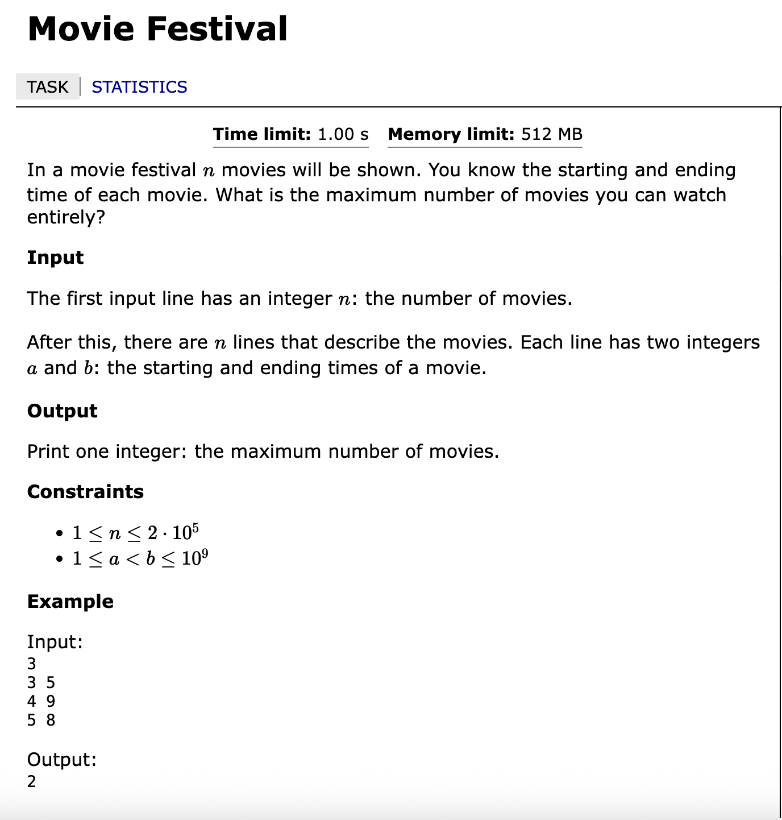

Slide 5
Do you know about custom comparator sorting?

Slide 6
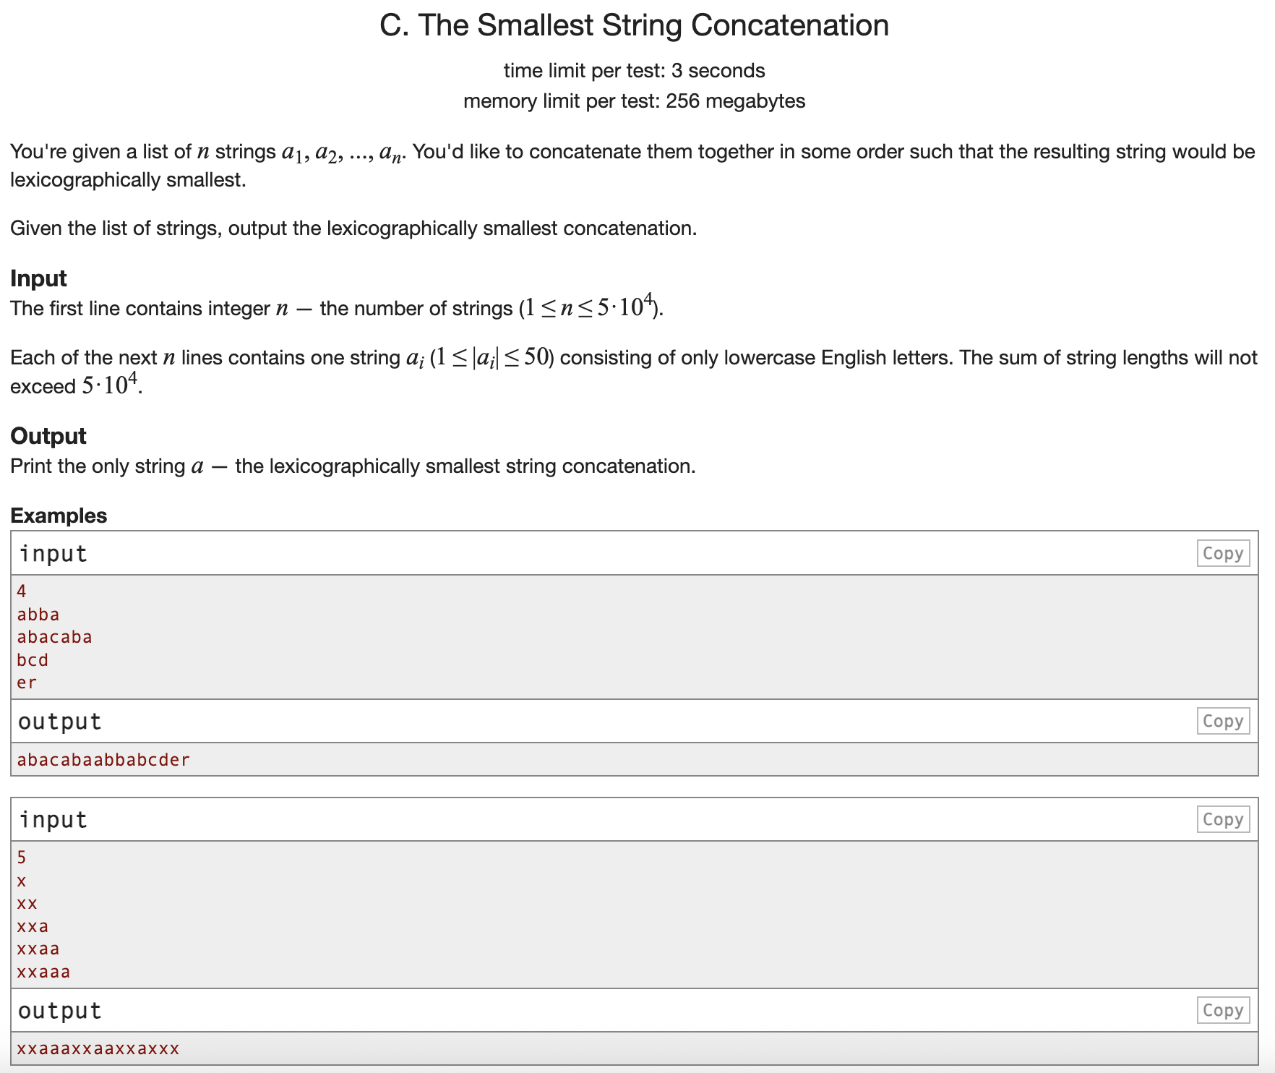

Slide 7
Binary Search
What is binary search?
Why it’s called binary search?
What problem it solves?
When it works and when it does not work?
Is it only for searching element in a sorted array?

Slide 8
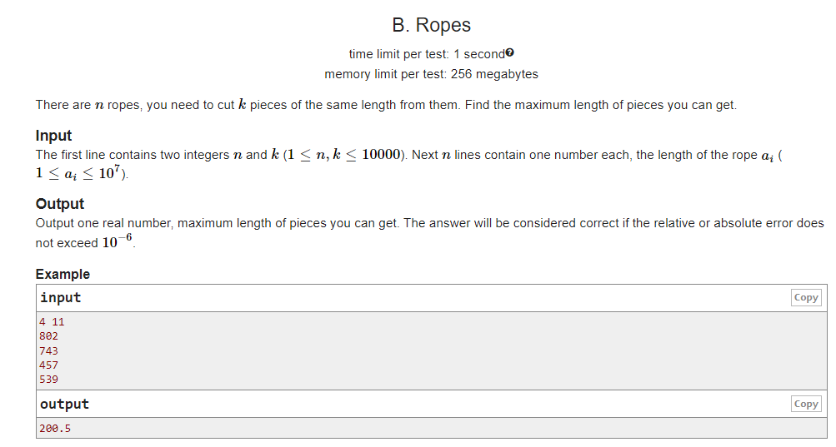

Slide 9
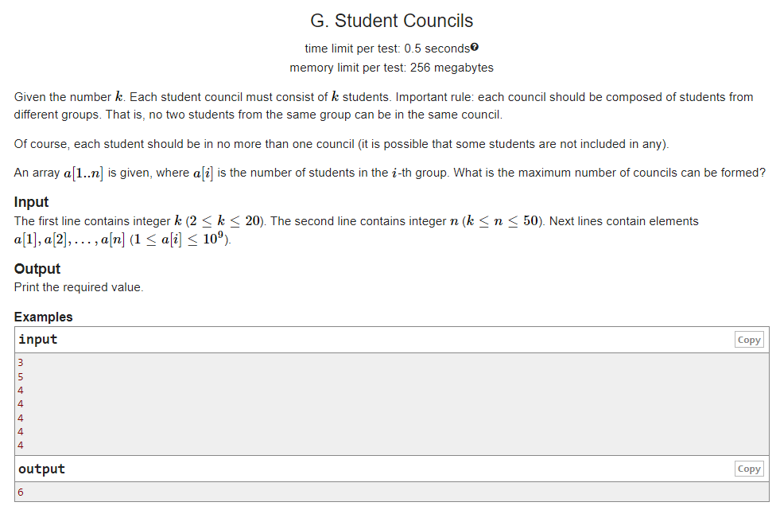

Slide 10
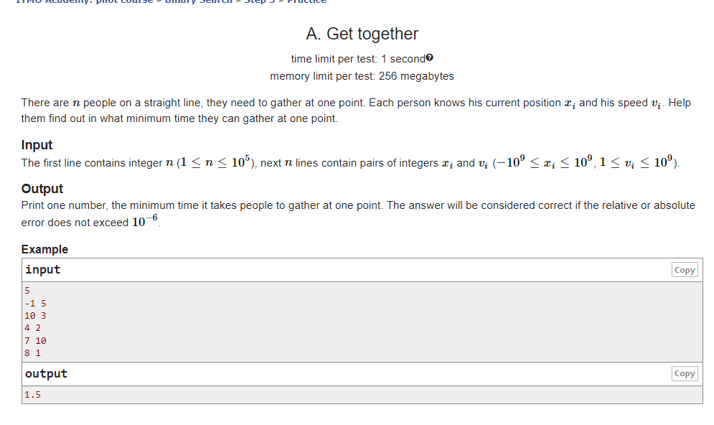

Slide 11
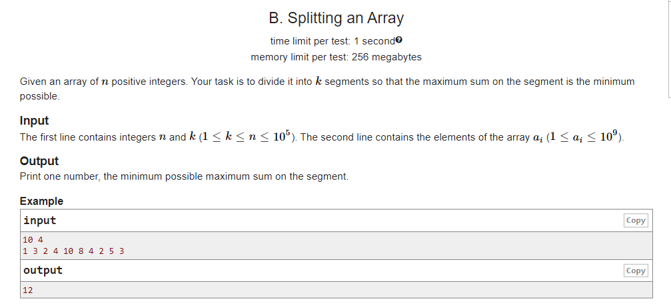

Slide 12
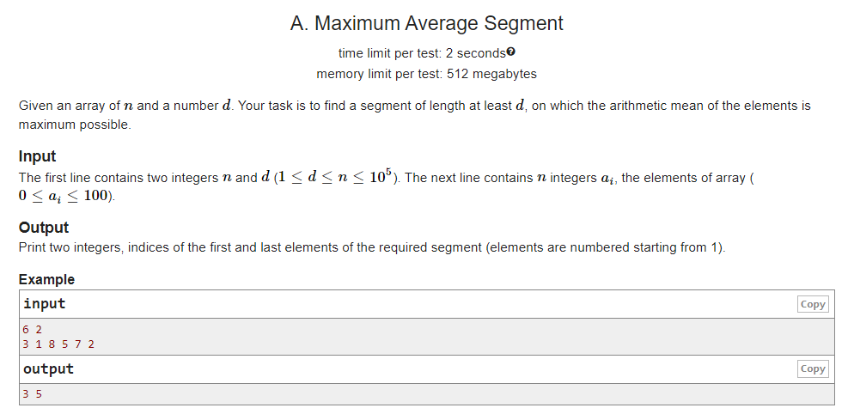

Slide 13
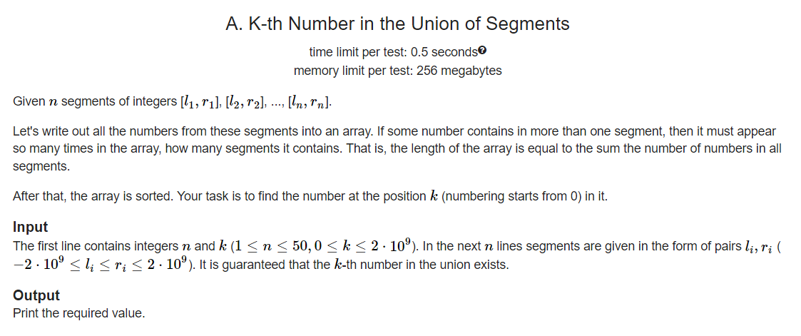

Slide 14
Ternary Search

Slide 15
How can you identify a ternary search problem?
What attributes the hold?
Complexity?
Can you make the complexity better?

Slide 16
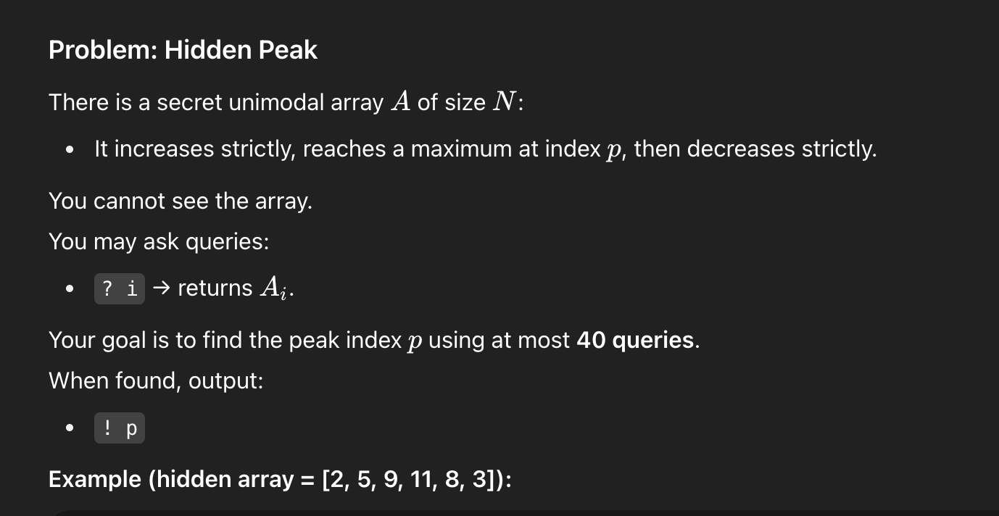

Slide 17
Why binary search will not work here?
How can ternary search help with that?
Can we make it better? Like binary search like complexity?

Slide 18
Meet in the middle

Slide 19
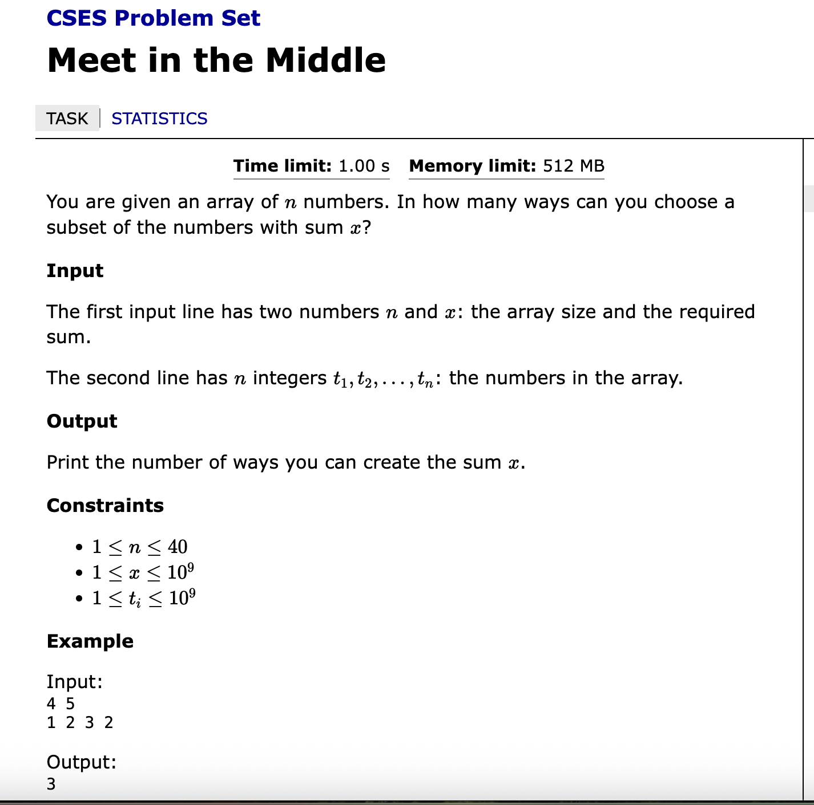

Slide 20
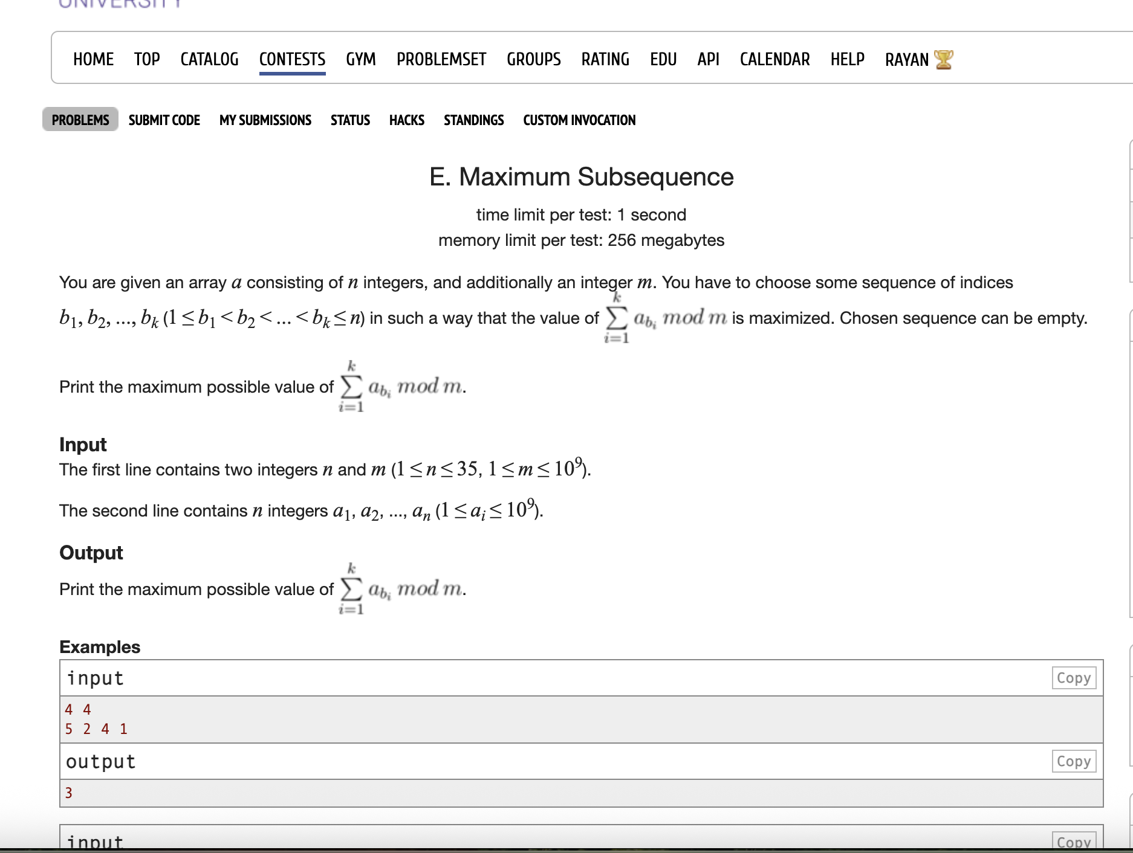

Slide 21
Let’s discuss more problems on BS if we’ve got time

Slide 22
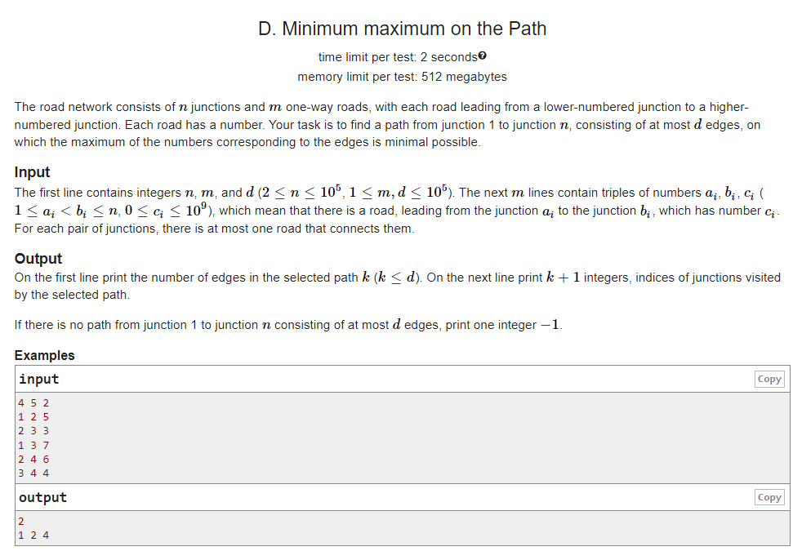

Slide 23
